Slide 1


Ashwini Muralidhar Rao
14/02/2023

Slide 2

Outline
Executive Summary
Introduction
Methodology
Results
Conclusion
Appendix

Slide 3
Executive Summary
The purpose of this study is to examine data on the SpaceX Falcon 9 obtained from multiple sources and use machine learning models to forecast the success of the first stage landing, giving other space agencies the choice of competing with SpaceX or not.
Summary of methodologies
Data collection: Collect data through API and Web scraping
Data Wrangling: Transform data through data wrangling
Data exploration: Conduct exploratory data analysis with SQL and data visuals
Interactive dashboard: Build an interactive map with folium to analyze launch site proximity Build a dashboard to analyze launch records interactively with Plotly Dash
Predictive modelling: Build a predictive model to predict if the first stage of Falcon 9 will land successfully
Summary of all results
This report will share results in various formats such as:
Data analysis results
Data visuals, interactive dashboards
Predictive model analysis results

Slide 4
Introduction
Project background and context
The space industry is becoming more and more mainstream and accessible to the general public as a result of recent advances in private space flight.
The cost of launch is still a major deterrent for new competitors entering the space race.
Approximately 62 million dollars are spent on each SpaceX flight, and stage 1 can be used again for subsequent launches.
This gives SpaceX a distinct advantage over rivals who typically spend more than 165 missions for each launch.
Problems you want to find answers
Identify the success of SpaceX Falcon 9's first stage's landing.
Effects of various factors/parameters on the results of landing (such as launch site, payload mass, booster version, etc.)
Correlations between launch sites and success rate

Slide 5

Section 1

Slide 6
Methodology
Executive Summary
Data collection methodology:
SpaceX API
Web scrap Falcon 9 and Falcon Heavy launch records from Wikipedia (link)
Perform data wrangling
Determined labels for training the supervised models by converting mission outcomes in to training labels (0-unsuccessful, 1-successful)
Perform exploratory data analysis (EDA) using visualization and SQL
Perform interactive visual analytics using Folium and Plotly Dash
Perform predictive analysis using classification models
Created a column for ‘class’; standardized and transformed data; train/test split data; find best classification algorithm (Logistic regression, SVM, decision tree, & KNN) using test data

Slide 7
Data Collection
The process of acquiring data from readily available sources is known as data collection. Structured, unstructured, or semi-structured data are all possible. Data was gathered for this project using the SpaceX API and web scraping Wiki pages for pertinent launch information.
SpaceX API
HTTP GET Request
Request Falcon 9 html page via HTTP GET method
Create Beautiful Soup
Create beautiful soup object from html response
Extract data to a pandas data frame
Convert new data frame to csv
To CSV
Extract the necessary data fields to satisfy the demand.
API Request
Request Launch Data from SpaceX API
Read API
Read JSON response and convert to data frame
Data Wrangling
Convert new data frame to csv
To CSV
Extract the necessary data fields to satisfy the demand.
Web Scraping Data

Slide 8
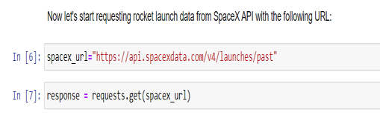
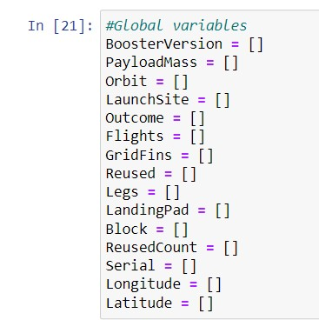
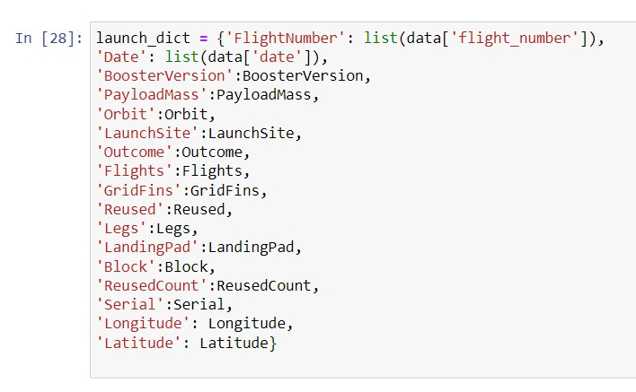
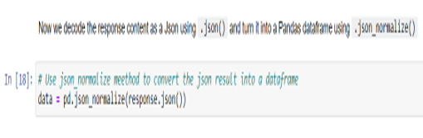
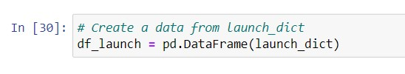

Data Collection – SpaceX API
1. API Request and Read Response into Data frame
2. Set Global Variables
4. Construct data using dictionary
5. Convert dictionary to data frame, filter Flcon9 launches and convert to csv
3. Helper functions with API calls to populate global variables
1.Create API GET request, normalize data and read in to a Dataframe:
2. Set Global Variables
4. Construct dataset from received data & combine columns into a dictionary:
3. Helper functions to get relevant data where columns have IDs (e.g., rocket column is an identification number)
getBoosterVersion(data)
getLaunchSite(data)
getPayloadData(data)
getCoreData(data)
5. Convert dictionary to data frame, filter Flcon9 launches and convert to csv
GITHUB LINK

Slide 9
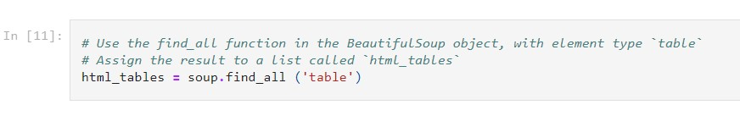
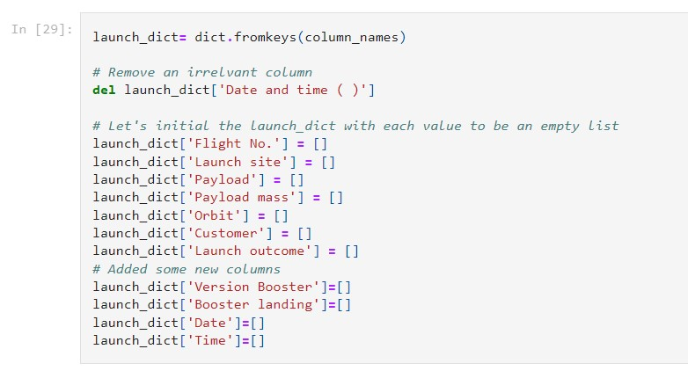
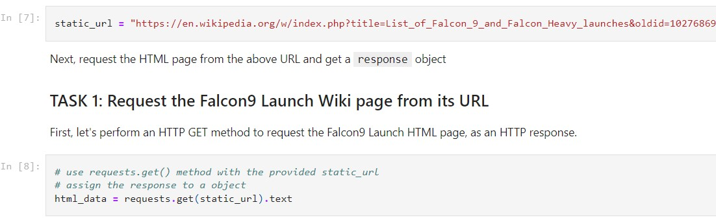
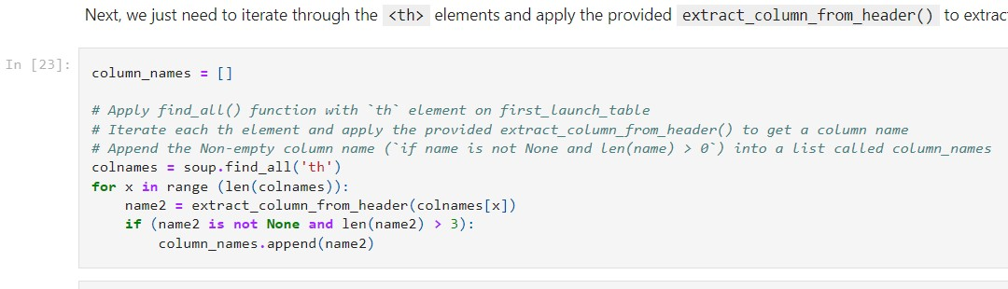
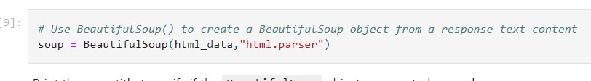
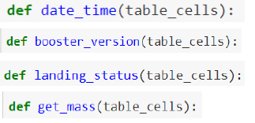
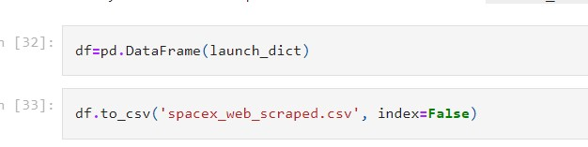
Data Collection - Scraping
1 Perform HTTP GET request Request HTML page
2. Create Beautiful Soup Object
3. Extract column names from HTML table header
4. Create dictionary with keys from extracted column names
5. Call helper functions and fill dict with launch records
6. Convert Dictionary to Data frame
1. Perform HTTP GET request and Request HTML page
3. Extract column names from HTML table header
4. Create dictionary with keys from extracted column names
2. Create a Beautiful Soup Object
6. Convert Dictionary to Data frame
5. Call helper functions and fill dict with launch records
GITHUB LINK

Slide 10
Data Wrangling
Exploratory Data Analysis (EDA) was carried out to identify patterns in the data and provide labels for supervised model training.
The data collection included a variety of mission outcomes that were transformed into Training Labels, with 1 denoting a booster that successfully landed and 0 denoting one that failed to do so.
To construct labels, the following landing circumstances were taken into account: True Ocean denotes that the mission's results were successfully landed in a particular area of the ocean, while False Ocean denotes that the results were unsuccessfully landed in that area of the ocean.
RTLS denotes that the mission's results were successfully landed on a ground pad
False RTLS denotes that they unsuccessfully landed on a ground pad.
True ASDS means the mission outcome was successfully landed on a drone ship
False ASDS means the mission outcome was unsuccessfully landed on a drone ship
GITHUB LINK

Slide 11
EDA with Data Visualization
Scatter plot: Demonstrates a connection or correlation between two variables, enabling the observation of patterns.
To visualize the relationships between the following:
Flight Number and Launch Site;
Payload and Launch Site;
Flight Number and Orbit Type; and
Payload and Orbit Type
Bar Chart: Widely used to contrast the values of a variable at a particular time. Barcharts make it simple to identify which groups are the highest/most prevalent as well as how other groups contrast with one another. Each bar's length reflects how much the products it symbolizes are worth.
Plotted the following Bar chart to visualize:
Relationship between the success rate of each orbit type
Line Chart: Commonly used to track changes over a period of time. It helps depict trends over time.
Plotted following Line chart to observe:
Average launch success yearly trend
GITHUB LINK

Slide 12
EDA with SQL
On an IBM DB2 cloud instance, the following SQL operations were carried out to better comprehend the SpaceX data set.
List the specific names of the space mission's distinct launch sites.
Show 5 records where the string "CCA" appears in the launch sites.
Show the total payload mass carried by NASA's rockets (CRS)
Show the average payload mass that the booster version F9 v1.1 can carry.
Indicate the day on which the first successful ground pad landing occurred.
Name the launchers with payload masses larger than 4,000 but less than 6,000 that have been successful in drone ships.
Total the number of mission outcomes that were successful and unsuccessful.
Name the booster models that have transported the most mass in payload. Employ a subquery
List the names of the launch sites, drone ship booster versions, and failure landing results for the year 201510. Sort the number of landing outcomes between 2010 06 04 and 2017 03 20 in descending order, such as Success (ground pad) or Failure (drone ship).
GITHUB LINK

Slide 13
Build an Interactive Map with Folium
Folium interactive map helps analyze geospatial data to perform more interactive visual analytics and better understand factors such as location and proximity of launch sites that impact launch success rateThe followingng map object were created and added to the map:
Mark all launch sites on the map. This allowed to visually see the launch sites on the map.
Added ‘foli um.circle’ and ‘folium.marker’ to highlight circle area with a text label over each launch site.
Added a ‘MarkerCluster()’ to show launch success (green) and failure (red) markers for each launch site.
Calculated distances between a launch site to its proximities (e.g., coastline, railroad, highway, city)
Added ‘MousePosition() to get coordinate for a mouse position over a point on the map
Added ‘folium.Marker()’ to display distance (in KM) on the point on the map (e.g., coastline, railroad, highway, city)
Added ‘folium.Polyline()’ to draw a line between the point on the map and the launch site
Repeated steps above to add markers and draw lines between launch sites and proximities –coastline, railroad, highway, city)
Building the Interactive Map with Folium helped answered following questions:
Are launch sites in close proximity torailways? YES
Are launch sites in close proximity tohighways? YES
Are launch sites in close proximity tocoastline? YES
Do launch sites keep certain distance away from cities? YES
GITHUB LINK

Slide 14
Build a Dashboard with Plotly Dash
Built a Plotly Dash web application to perform interactive visual analytics on SpaceX launch data in real-time.
Added Launch Site Drop-down, Pie Chart, Payload range slide, and a Scatter chart to the Dashboard.
Added a Launch Site Drop-down Input component to the dashboard to provide an ability to filter Dashboardvisualsl by all launch sites or a particular launch site
Added a Pie Chart to the Dashboard to show total success launches when ‘All Sites’ is selected and show success and failed counts when a particular site is selected
Added a Payload range slider to the Dashboard to easily select different payload ranges to identify visual patterns
Added a Scatter chart to observe how payload may be correlated with mission outcomes for selected site(s). The color-label Booster version on each scatter point provided missions outcomes with different boosters
Dashboard helped answer the following questions:
Which site has the largest successful launches? KSC LC-39A with 10
Which site has the highest launch success rate? KSC LC-39A with 76.9% success
Which payload range(s) has the highest launch success rate? 2000 –5000 kg
Which payload range(s) has the lowest launch success rate? 0-2000 and 5500 -7000
Which F9 Booster version (v1.0, v1.1, FT, B4, B5, etc.) has the highest launch success rate? FT
GITHUB LINK

Slide 15
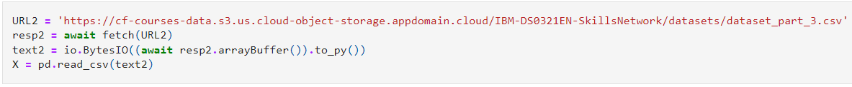
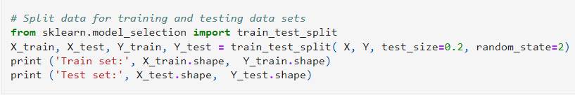
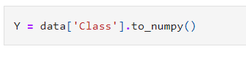
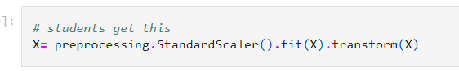
Predictive Analysis (Classification)
1. Read Dataset into Dataframe and create class array
2. Standardize the Data
3. Train/Test/Split data into training and test set
4. Create and refine Models
5. Find the Best Performing Model
1. Read Dataset into Dataframe and create class array
3. Train/Test/Split data into training and test set
4. Create and refine Models
Create a Logistic Regression object and then create a GridSearchCV object
Fit train data set in to the GridSearchCV object and train the Model
Find and display best hyperparameters and accuracy score
Check the accuracy on the test data by creating a confusion matrix
Repeat above steps for Decision Tree, KNN, and SVM algorithms
2. Standardize the Data
5. Find the Best Performing Model
GITHUB LINK

Slide 16
Results
Exploratory data analysis results
Interactive analytics demo in screenshots
Predictive analysis results

Slide 17

Section 2

Slide 18
Flight Number vs. Launch Site
Success rates (Class=1) increase as the number of flights increase
For the launch site ‘KSC LC 39A’, it takes at least around 25 launches before a first successful launch

Slide 19
Payload vs. Launch Site
For launch site ‘VAFB SLC 4E’, there are no rockets launched for payload greater than 10,000 kg
The percentage of successful launches (Class=1) increases for launch site ‘VAFB SLC 4E’ as the payload mass increases
There is no clear correlation or pattern between the launch site and payload mass

Slide 20
Success Rate vs. Orbit Type
Orbits ES-LI, GEO, HEO, and SSO have the highest success rates
GTO orbit has the lowest success rate

Slide 21
Flight Number vs. Orbit Type
For orbit VLEO, first successful landing (class=1) doesn’t occur until 60+ number of flights
For most orbits (LEO, ISS, PO, SSO, MEO, VLEO) successful landing rates appear to increase with flight numbers
There is no relationship between flight number and orbit for GTO

Slide 22
Payload vs. Orbit Type
Successful landing rates (Class=1) appear to increase with pay load for orbits LEO, ISS, PO, and SSO
For GEO orbit, there is not clear pattern between payload and orbit for successful or unsuccessful landing

Slide 23
Launch Success Yearly Trend
Success rate (Class=1) increased by about 80% between 2013 and 2020
Success rates remained the same between 2010 and 2013 and between 2014 and 2015
Success rates decreased between 2017 and 2018 and between 2019 and 2020

Slide 24
All Launch Site Names
Query:
Description:
‘distinct’ returns only unique values from the queries column (Launch_Site)
There are 4 unique launch sites
Result:

Slide 25
Launch Site Names Begin with 'CCA'
Query:
Description:
Using the keyword ‘Like’ and format ‘CCA%’, returns records where ‘Launch Site’ column starts with “CCA”.
Limit 5, limits the number of returned records to 5
Result:

Slide 26
Total Payload Mass
Query:
Description:
‘sum’ adds column ‘PAYLOAD_MASS_KG’ and returns total payload mass for customers named ‘NASA (CRS)’
Result:

Slide 27
Average Payload Mass by F9 v1.1
Query:
Description:
‘avg’ keyword returns the average of payload mass in ‘PAYLOAD_MASS_KG’ column where booster version is ‘F9 v1.1’
Result:

Slide 28
First Successful Ground Landing Date
Query:
Description:
‘min(Date)’ selects the first or the oldest date from the ‘Date’ column where first successful landing on group pad was achieved
Where clause defines the criteria to return date for scenarios where ‘Landing_Outcome’ value is equal to ‘Success (ground pad)’
Result:

Slide 29
Successful Drone Ship Landing with Payload between 4000 and 6000
Query:
Description:
The query finds the booster version where payload mass is greater than 4000 but less than 6000 and the landing outcome is success in drone ship
The ‘and’ operator in the where clause returns booster versions where both conditions in the where clause are true
Result:

Slide 30
Total Number of Successful and Failure Mission Outcomes
Query:
Description:
The ‘group by’ keyword arranges identical data in a column in to group
In this case, number of mission outcomes by types of outcomes are grouped in column ‘counts’
Result:

Slide 31
Boosters Carried Maximum Payload
Query:
Description:
The sub query returns the maximum payload mass by using keywork ‘max’ on the pay load mass column
The main query returns booster versions and respective payload mass where payload mass is maximum with value of 15600
Result:

Slide 32
2015 Launch Records
Query:
Description:
The query lists landing outcome, booster version, and the launch site where landing outcome is failed in drone ship and the year is 2015
The ‘and’ operator in the where clause returns booster versions where both conditions in the where clause are true
The ‘year’ keywork extracts the year from column ‘Date
The results identify launch site as ‘CCAFS LC-40’ and booster version as F9 v1.1 B1012 and B1015 that had failed landing outcomes in drop ship in the year 2015
Result:

Slide 33
Rank Landing Outcomes Between 2010-06-04 and 2017-03-20
Query:
Description:
The ‘group by’ key word arranges data in column ‘Landing__Outcome’ into groups
The ‘between’ and ‘and’ keywords return data that is between 2010-06-04 and 2017-03-20
The ‘order by’ keyword arranges the counts column in descending order
The result of the query is a ranked list of landing outcome counts per the specified date range
Result:

Slide 34

Section 3

Slide 35
SpaceX Falcon9 -Launch Sites Map
Global Map
Zoom 2
Global Map on the left-top displays the Global map with Falcon 9 launch sites that are located in the United States (in California and Florida). Each launch site contains a circle, label, and a popup to highlight the location and the name of the launch site. It is also evident that all launch sites are near the coast.
Zoom1 and Zoom 2 into the launch sites to display 4 launch sites:
VAFB SLC-4E (CA)
CCAFS LC-40 (FL)
KSC LC-39A (FL)
CCAFS SLC-40 (FL)2
Zoom 1

Slide 36
SpaceX Falon9 –Success/Failed Launch Map for all Launch Sites
Figure 1 is the US map with all the Launch Sites. The numbers on each site depict the total number of successful and failed launches
Figure 2, 3, 4, and 5 zoom in to each site and displays the success/fail markers with green as success and red as failed
By looking at each site map, KSC LC-39A Launch Site has the greatest number of successful launches
Fig 1 –US map with all Launch Sites
Fig 2 –VAFB Launch Site with
success/failed markers
Fig 3 –KSC LC-39A
success/failed markers
Fig 4 –CCAFS SLC-40
success/failed markers
Fig 5 –CCAFS SLC-40
success/failed markers

Slide 37
SpaceX Falcon9 –Launch Site to proximity Distance Map
Fig 1 –Proximity site map for VAFB SLC-4E
Fig 2 –Zoom in for sites –coastline, railroad, and highway
Figure 1 displays all the proximity sites marked on the map for Launch Site VAFB SLC-4E. City Lompoc is located further away from Launch Site compared to other proximities such as coastline, railroad, highway, etc. The map also displays a marker with city distance from the Launch Site (14.09 km)
Figure 2 provides a zoom in view into other proximities such as coastline, railroad, and highway with respective distances from the Launch Site
In general, cities are located away from the Launch Sites to minimize impacts of any accidental impactsto the general public and infrastructure. Launch Sites are strategically located near the coastline, railroad, and highways to provide easy access to resources.

Slide 38

Section 4

Slide 39
Launch Success Counts For All Sites
Launch Site ‘KSC LC-39A’ has the highest launch success rate
Launch Site ‘CCAFS SLC-40’ has the lowest launch success rate

Slide 40
Launch Site with Highest Launch Success Ratio
KSC LC-39A Launch Site has the highest launch success rate and count
Launch success rate is 76.9%
Launch successfailurerateis23.1%

Slide 41
Payload vs. Launch Outcome Scatter Plot for All Sites
Most successful launches are in the payload range from 2000 to about 5500
Booster version category ‘FT’ has the most successful launches
Only booster with a success launch when payload is greater than 6k is ‘B4’

Slide 42

Section 5

Slide 43
Classification Accuracy
Based on the Accuracy scores and as also evident from the bar chart, the Decision Tree algorithm has the highest classification score with a value of .8750
Accuracy Score on the test data is the same for all the classification algorithms based on the data set with a value of .8333
Given that the Accuracy scores for Classification algorithms are very close and the test scores are the same, we may need a broader dataset to further tune the models

Slide 44
Confusion Matrix
The confusion matrix is the same for all the models (LR, SVM, Decision Tree, KNN)
•Per the confusion matrix, the classifier made 18 predictions
•12scenarios were predicted Yes for landing, and they did land successfully (True positive)
•3scenarios (top left) were predicted No for landing, and they did not land (True negative)
•3 scenarios (top right) were predicted Yes for landing, but they did not land successfully (False positive)
•Overall, the classifier is correct about 83% of the time ((TP + TN) / Total) with a misclassification or error rate ((FP + FN) / Total) of about 16.5%

Slide 45
Conclusions
As the number of flights increases, the first stage is more likely to land successfully
Success rates appear to go up as Payload increases but there is no clear correlation between Payload mass and success rates
Launch success rate increased by about 80% from 2013 to 2020
Launch Site ‘KSC LC-39A’ has the highest launch success rate and Launch Site ‘CCAFS SLC-40’ has the lowest launch success rate
Orbits ES-L1, GEO, HEO, and SSO have the highest launch success rates, and orbit GTO has the lowest
Launch sites are located strategically away from the cities and closer to the coastline, railroads, and highways
The best-performing Machine Learning Classification Model is the Decision Tree with an accuracy of about 87.5%. When the models were scored on the test data, the accuracy score was about 83% for all models. More data may be needed to further tune the models and find a potentially better fit.

Slide 46
Appendix
Include any relevant assets like Python code snippets, SQL queries, charts, Notebook outputs, or data sets that you may have created during this project

Slide 47


